Slide 1
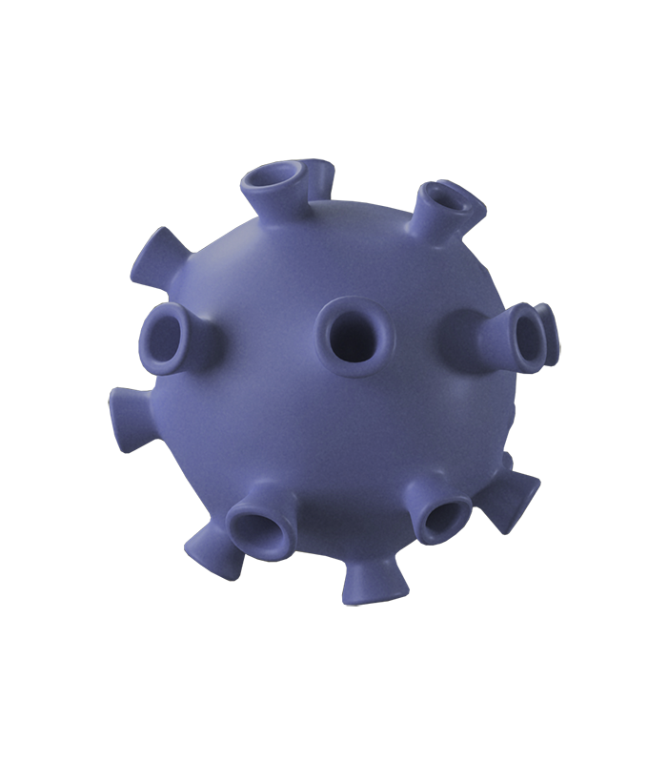
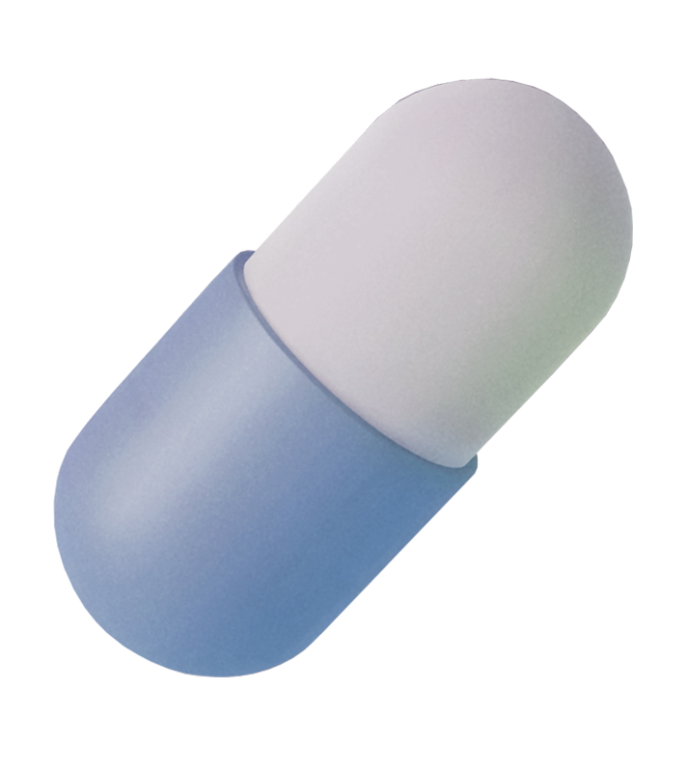
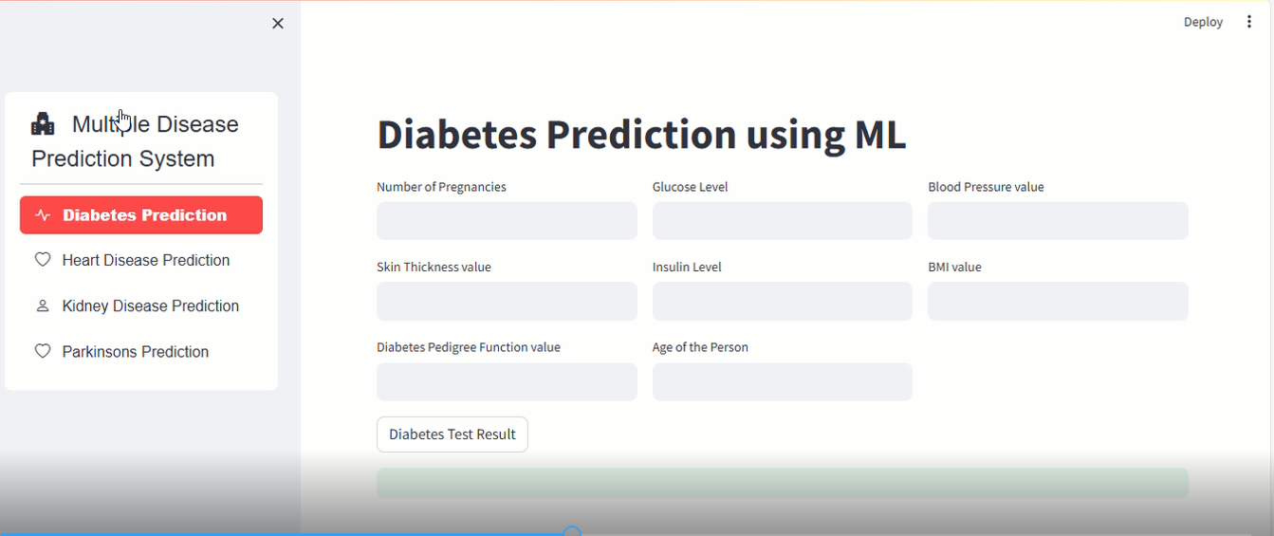
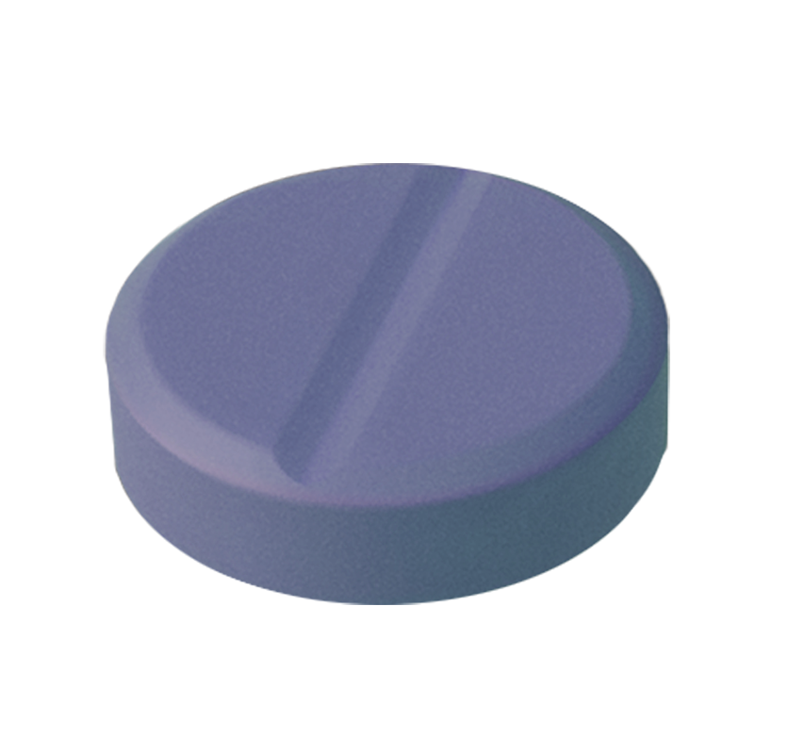
Multi-Disease Prediction System
Presented by Group 5
Raju Ahmed Rabby 2013823642
Musfika Tasnim Fariha 2014126642
Tasin MdAwdri 1912801642
FarhanaAkther Layba Mitu 1911184042
Rashedul Islam 182178042

Slide 2
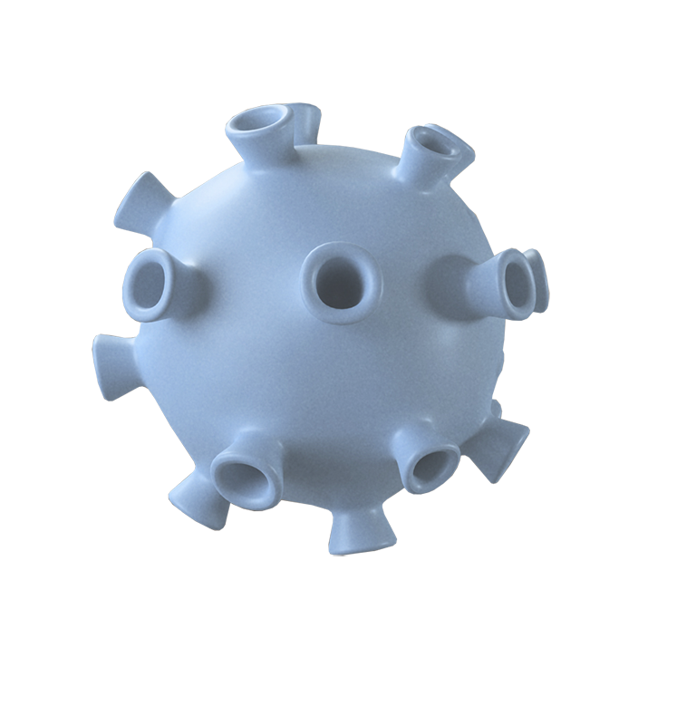
Introduction
The rising prevalence of chronic and life-threatening diseases, early diagnosis and prediction has become essential in modern healthcare. This project aims to develop a comprehensive multi-disease prediction system that integrates both patient metadata and medical imaging to accurately assess the likelihood of various diseases. Our goal Develop a multi disease prediction system using patient metadata and medical image. Using machine learning and deep learning models for disease prediction.

Slide 3
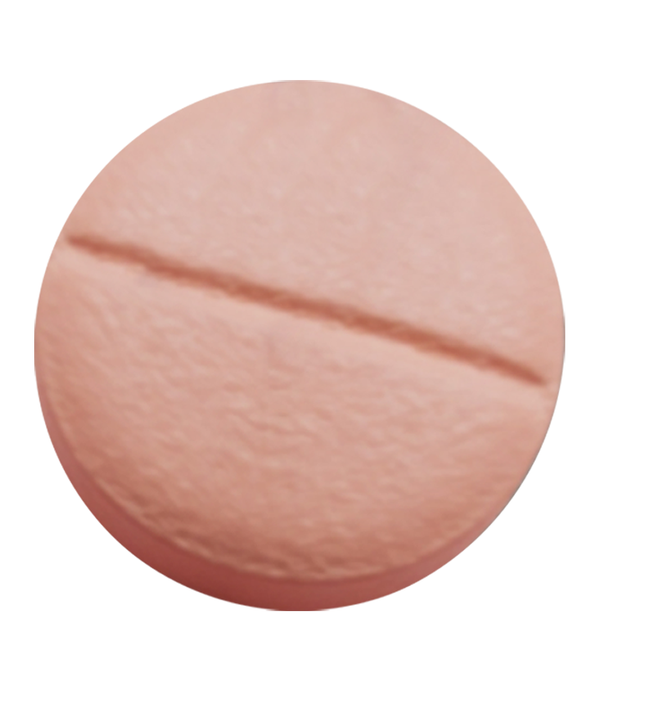

Impact of the project
Can help doctor catch disease early, making treatments better and saving lives.
People at risk can get the right help sooner.
Can also help scientists learn more about using computers to predict health problems.
Overall its about making healthcare better for everyone.

Slide 4
Project Scope and Objectives
Phase 1: Metadata-Based Disease
Prediction Models
Phase 2: Image-Based Disease Detection Models
In this phase, we will develop predictive models that analyze patient demographic and clinical data to assess the likelihood of various diseases. As like Diabetes, Heart Disease Prediction, Stroke Prediction, Parkinson’s disease Prediction etc.
In this phase, we will develop deep learning models for disease detection using medical imaging data. As like Brain Tumor Detection from MRI Scan, Pneumonia Detection from Chest X-ray, COVID-19 Detection from Chest X-ray etc.

Slide 5

Methodology
Dataset Collection:
We will utilize public datasets such as:
Cancer: SEER or UCI dataset
Stroke: Kaggle's Stroke Prediction Datase
Alzheimer’s: Open Access Series of Imaging Studies (OASIS
CKD: UCI CKD Datase
MRI, X-ray, and Dermoscopic Images: Sources include Kaggle, NIH, and ISIC Archive

Slide 6
Model Development:
Model Evaluation
Phase 1 (Metadata Models): Machine Learning models such as Logistic Regression Random Forests, XGBoost, and Neural Networks will be trained to predict disease risks.
Phase 2 (Image Models): Convolutional Neural Networks (CNNs) and pre-traine architectures like ResNet, VGG, or EfficientNet will be employed for image classification tasks
Performance metrics such as accuracy, precision, recall, F1-score, andAUC-ROC wil be used to evaluate the models.
Cross-validation and hyperparameter tuning will ensure robust predictions

Slide 7

Web-Based Application
Users will be able to upload patient metadata or medical images to get instant predictions
Get instant disease prediction Web interface designed for both healthcare and professionals and patient

Slide 8
Timeline
Month | Task | Details
Month 1 | Data Collection for Metadata Projects | Collect datasets for Cancer, Stroke, Alzheimer’s, and CKD.
Month 2 | Preprocessing Metadata | Clean and preprocess metadata for model training.
Month 3 | Model Development: Cancer & Stroke Prediction | Develop and train ML models for Cancer and Stroke Prediction.
Month 4 | Model Development: Alzheimer’s & CKD Prediction | Develop and train ML models for Alzheimer’s and CKD Prediction.
Month 5 | Model Evaluation & Optimization (Metadata Models) | Evaluate models and fine-tune hyperparameters.
Month 6 | Web App Development (Phase 1 Integration) | Integrate metadata-based models into the web application.
Month 7 | Data Collection & Preprocessing for Image-Based Models | Collect and preprocess MRI, X-ray, and dermoscopic images.
Month 8 | Model Development: Brain Tumor & Pneumonia Detection | Develop CNN models for brain tumors and pneumonia detection.
Month 9 | Model Development: Skin Cancer & COVID-19 Detection | Train deep learning models for skin cancer and COVID-19 detection.
Month 10 | Model Evaluation, Web App Integration & Final Testing | Integrate image models into the web app and perform testing.

Slide 9
Tools and technologies
Programming Languages: Python, JavaScrip
Machine Learning Libraries: Scikit-learn, TensorFlow, Keras, PyTorc
Web Frameworks: Django/Flask (Backend), React/HTML/CSS (Frontend
Cloud Platforms: AWS/GCP/Azure for model hosting and deploymen
Hardware: GPU support for deep learning tasks (e.g., NVIDIAGPUs

Slide 10

Conclusion
This project aims to leverage the power of machine learning and deep learning to create a comprehensive multi-disease prediction system. metadata and image-based data, the system will provide accurate predictions, contributing to early diagnosis and improved healthcare outcomes. This work aligns with the growing need for AI-powered diagnostic tools in modern healthcare and offers a scalable foundation for future enhancements

Slide 11
References
I. Smith, J., & Doe, A. (2023). "Machine Learning Approaches for Predicting Diabetes Mellitus." Journal of Medical Informatics, 45(2), 123-134.
II. Tiwari, A., Chugh, A., & Sharma, A. (2023). "Ensemble Framework for Cardiovascular Disease Prediction." arXiv preprint arXiv:2306.09989. [Online]. Available: https://arxiv.org/abs/2306.09989
III. Jain, N. (2022). "Stroke Prediction Using Machine Learning Techniques." Kaggle. [Online]. Available: https://www.kaggle.com
IV. Lee, H., Park, M. W., & Park, D. J. (2021). "Development of Machine Learning Model for Diagnostic Disease Prediction Based on Laboratory Tests." Scientific Reports, 11(1), 7567. [Online]. Available: https://www.nature.com/articles/s41598-021-87171-5
V. Franz, L., Shrestha, Y. R., & Paudel, B. (2020). "A Deep Learning Pipeline for Patient Diagnosis Prediction Using Electronic Health Records." arXiv preprint arXiv:2006.16926. [Online]. Available: https://arxiv.org/abs/2006.16926
VI. UCI Machine Learning Repository. (2021). "Chronic Kidney Disease Dataset." UCI. [Online]. Available: https://archive.ics.uci.edu/ml/datasets/Chronic_Kidney_Disease
VII. Chan, T. (2022). "Brain Tumor Detection from MRI Scans Using CNN." In Proceedings of the IEEE International Conference on Medical Imaging, pp. 113-120.
VIII. National Institutes of Health (NIH). (2021). "Chest X-Ray Pneumonia Dataset." NIH. [Online]. Available: https://www.nih.gov
IX. International Skin Imaging Collaboration (ISIC). (2022). "Skin Lesion Analysis Towards Melanoma Detection." ISIC Archive. [Online]. Available: https://www.isic-archive.com
X. Rahman, M. (2021). "COVID-19 Detection Using Chest X-Rays and CNN." IEEE Access, 9, 103567-103574.

